Slide 1

Customers Behavior ETL

Slide 2
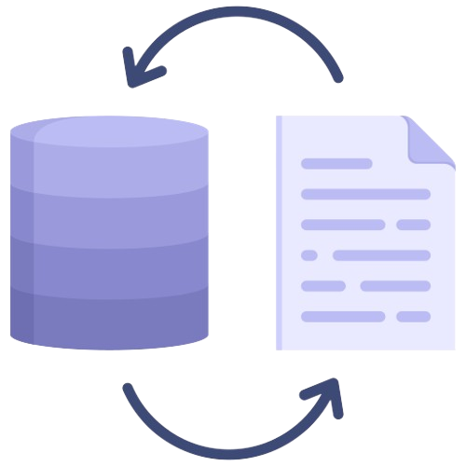


What is ETL ?
01.
02.
03.
Extract
Transform
Load
Collect the raw data from different platforms
( CSVs files )
Clean the data , change the format to make it matchable
Load the data into a data base

Slide 3
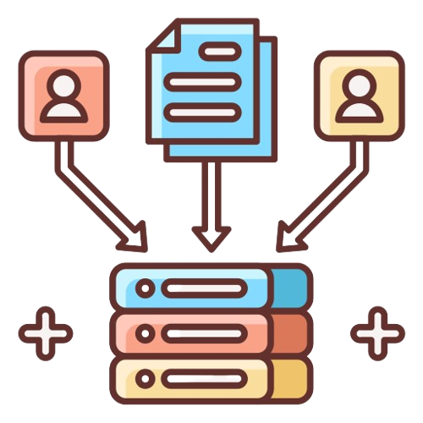

Project Main Goals
01.
Collect the data of the customers From various places
Make it arranged for the data analysis to give insights about the business
02.

Slide 4





Tools
Tools & services we used in the project
Azure Blob storage
Azure data factory
Azure data lake
Azure data studio
Data base
Power BI

Slide 5
1- Data source
Project Timeline
2- Load to Azure Data storage
6- Make Quires for Power BI
3- Create piplelines
5- Transform data
4- Load data to sql server

Slide 6
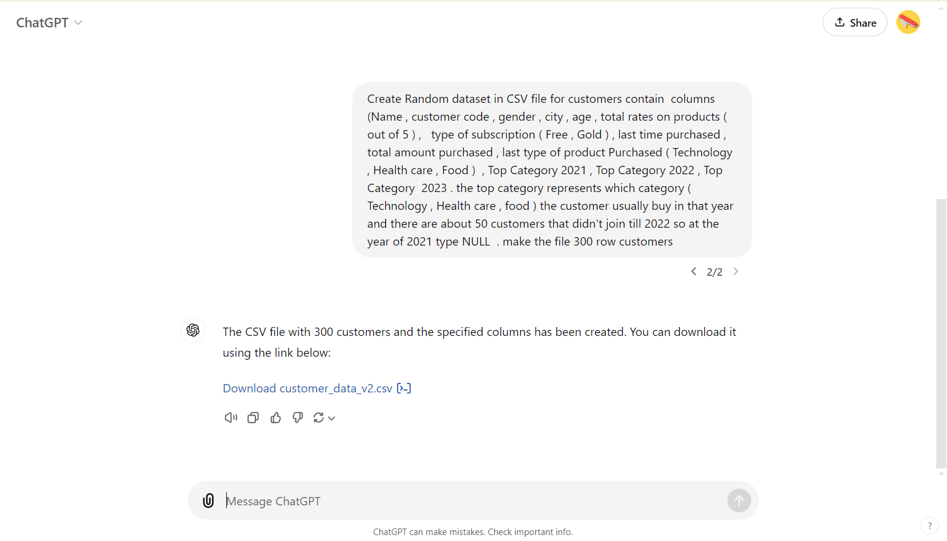
1- Data source
Generated by Chat GPT and stored in internal sotrage of the computer
welcome essage.

Slide 7
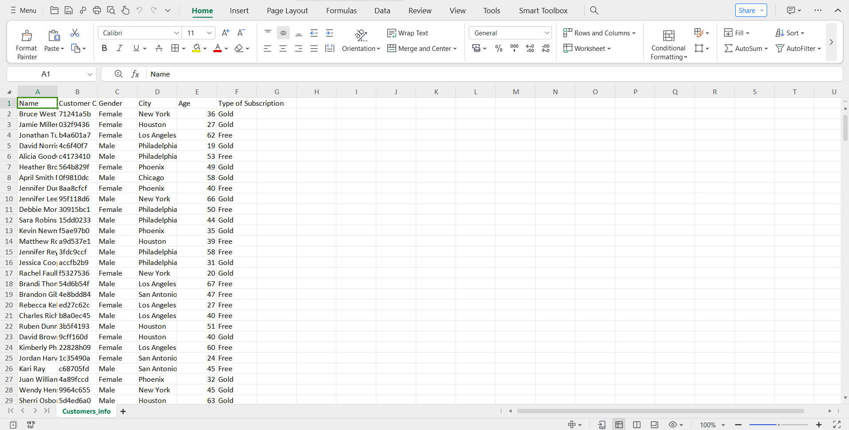
About Us
We Always help you Business Better And Bigger
The user can perform the presentation on a projector or computer, and the powerpoint can be printed out and made into film.

Slide 8
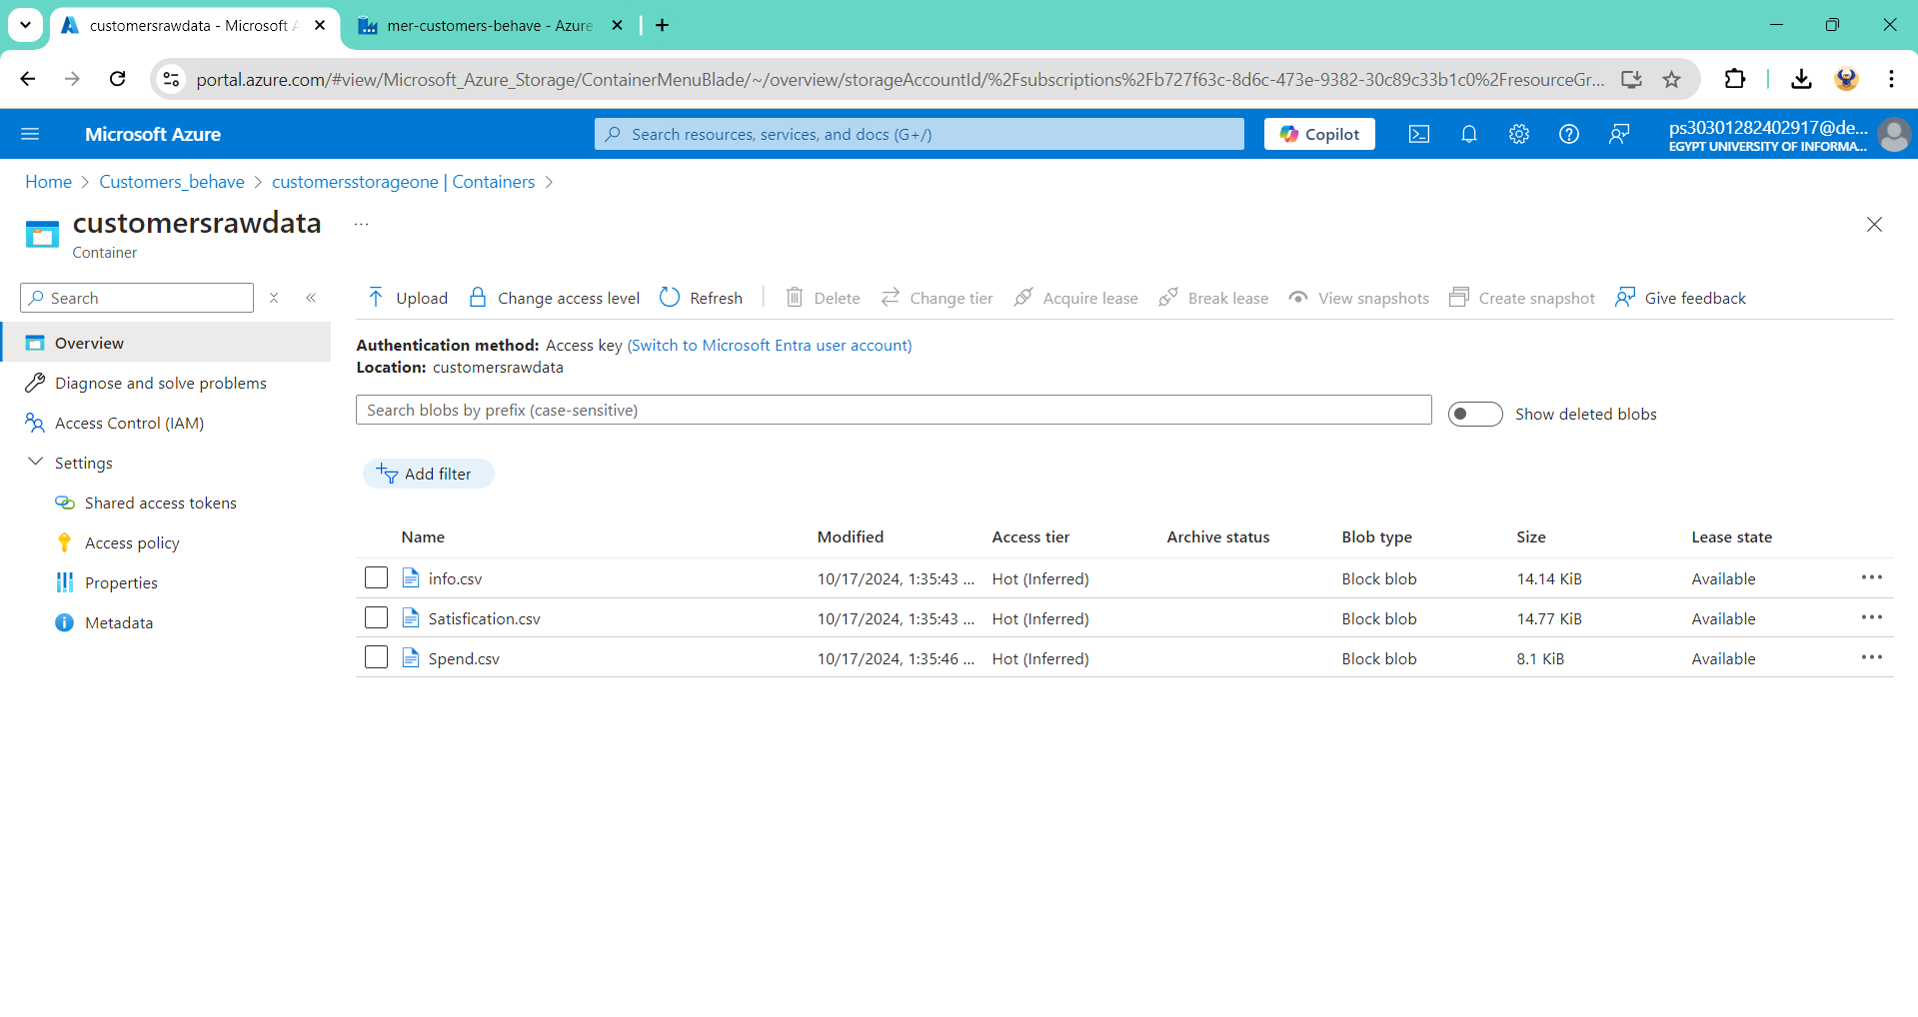
2- Load to Azure Data storage
welcome essage.

Slide 9
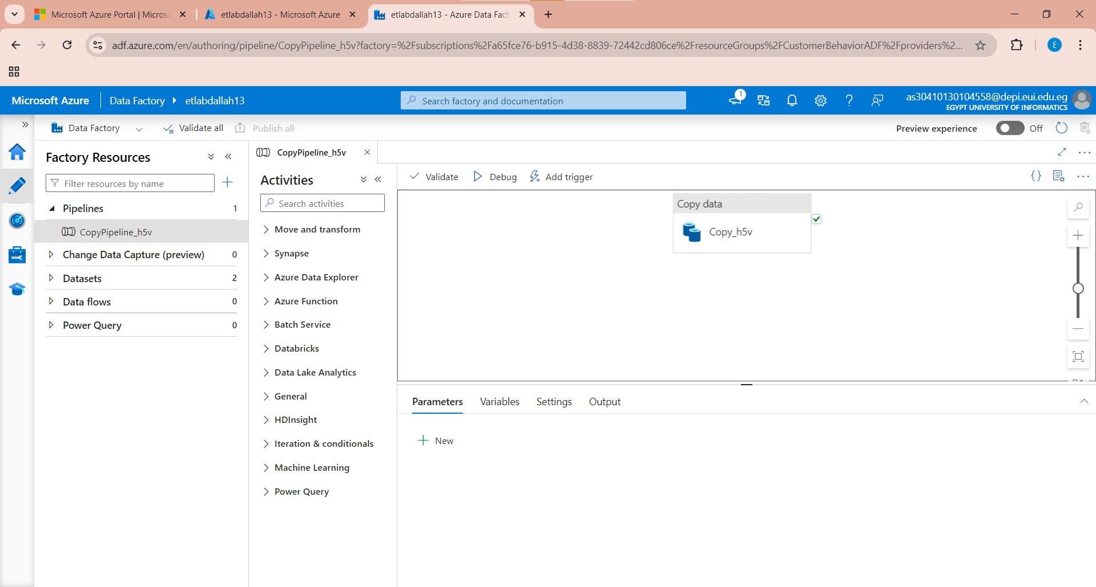
3- Create piplelines

Slide 10
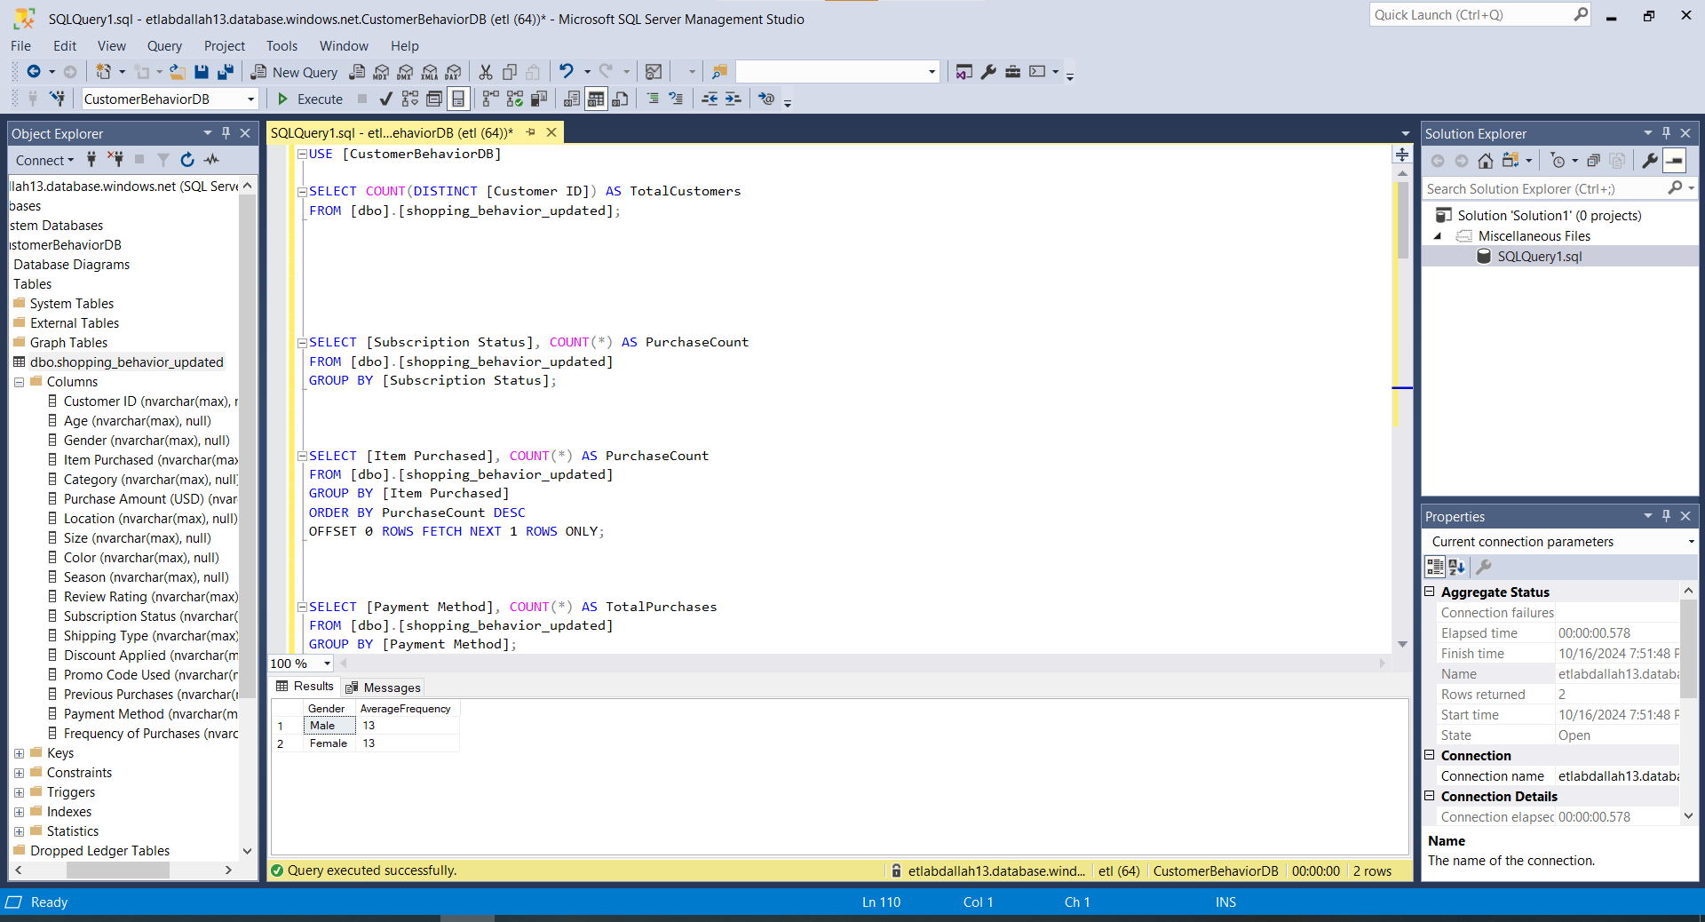
4- Load data to sql server
5- Transform data
6- Make Quires for Power BI

Slide 11
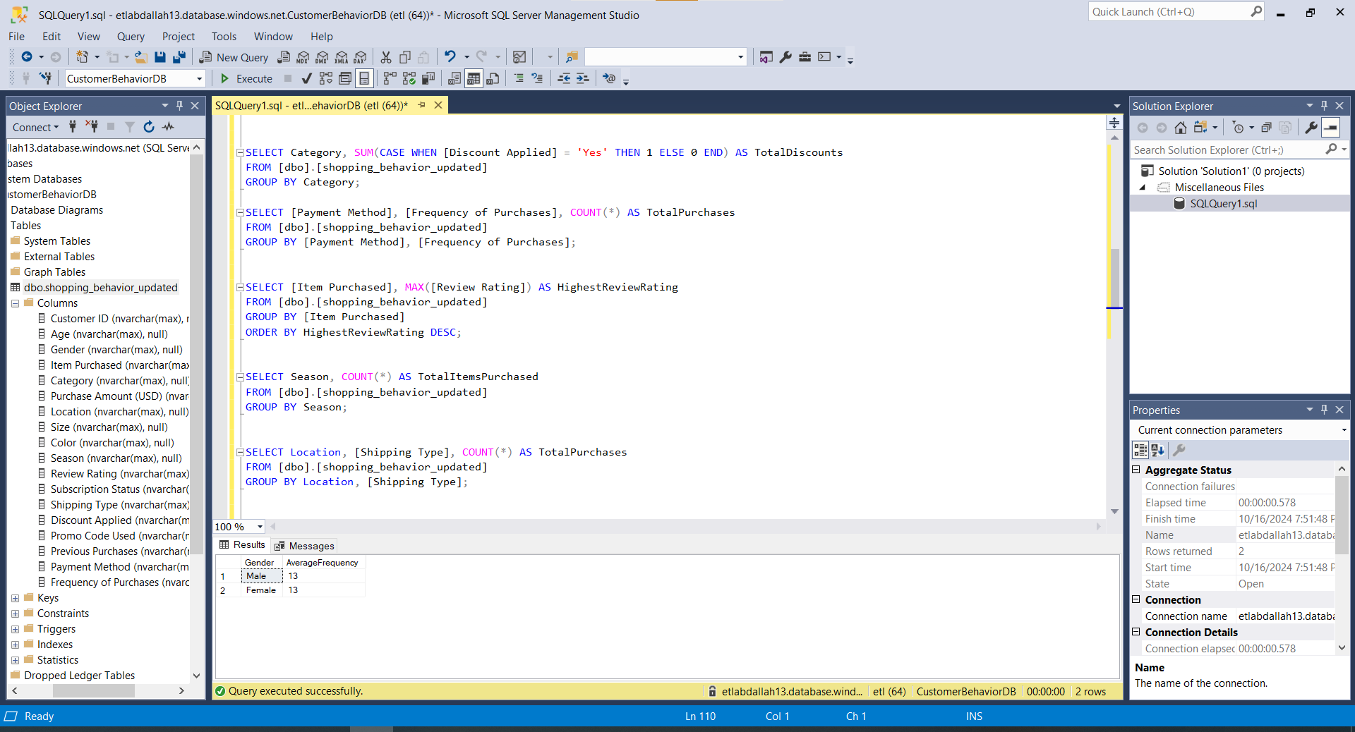

Slide 12
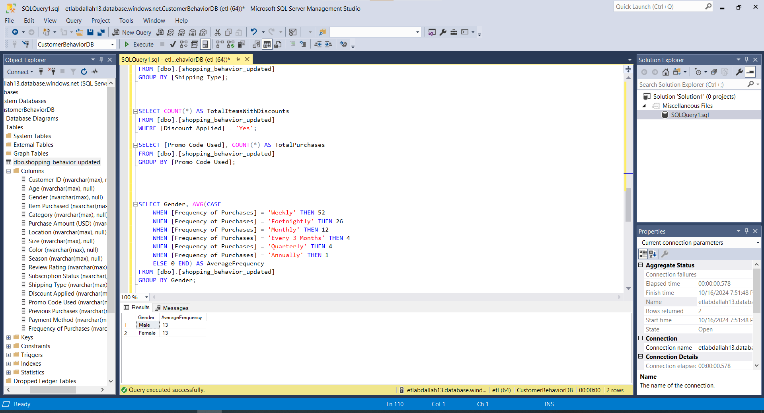

Slide 13
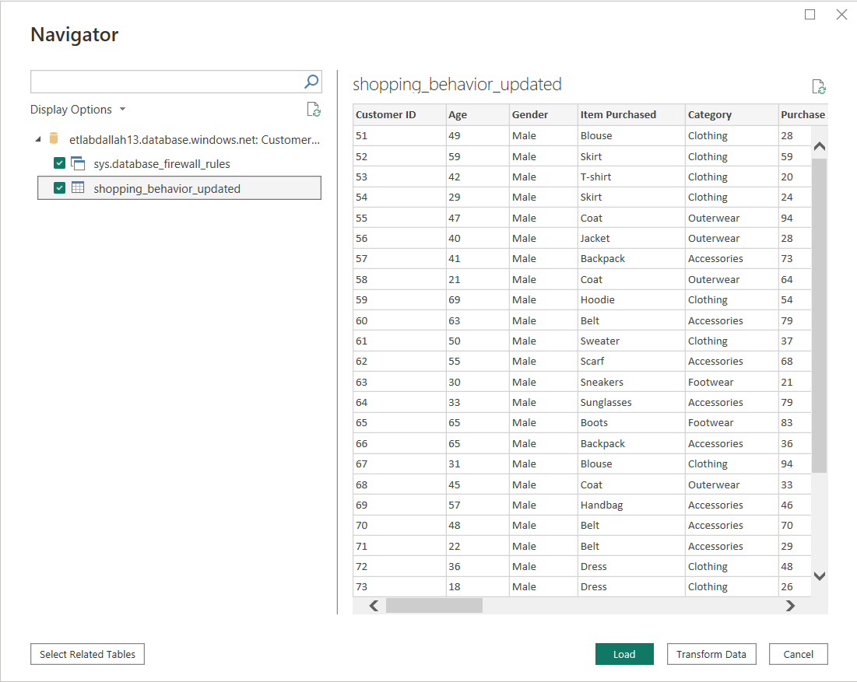

Slide 14
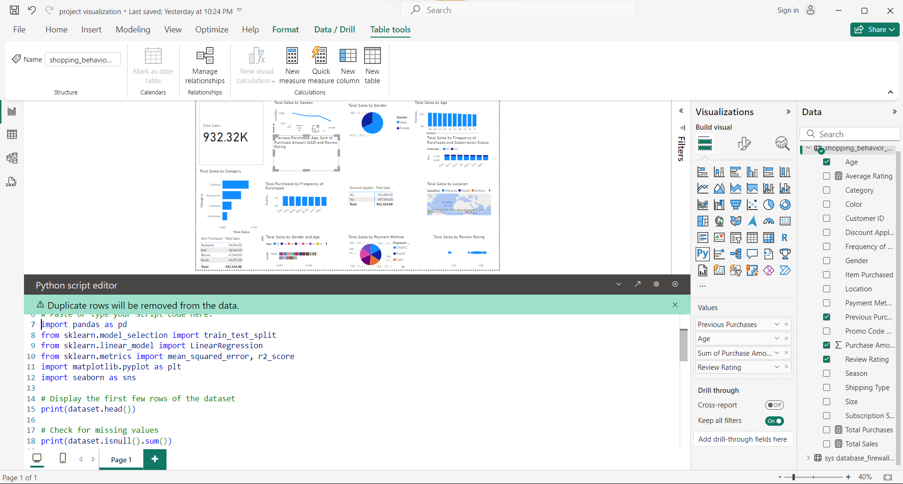

Slide 15
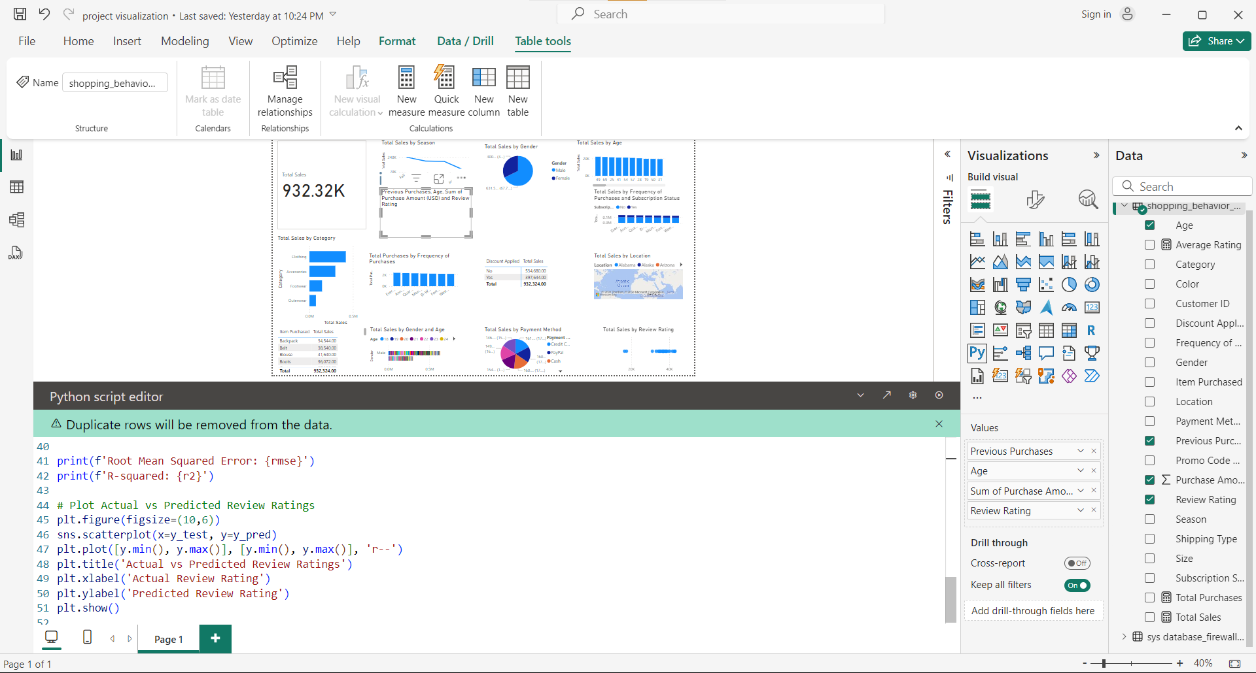

Slide 16
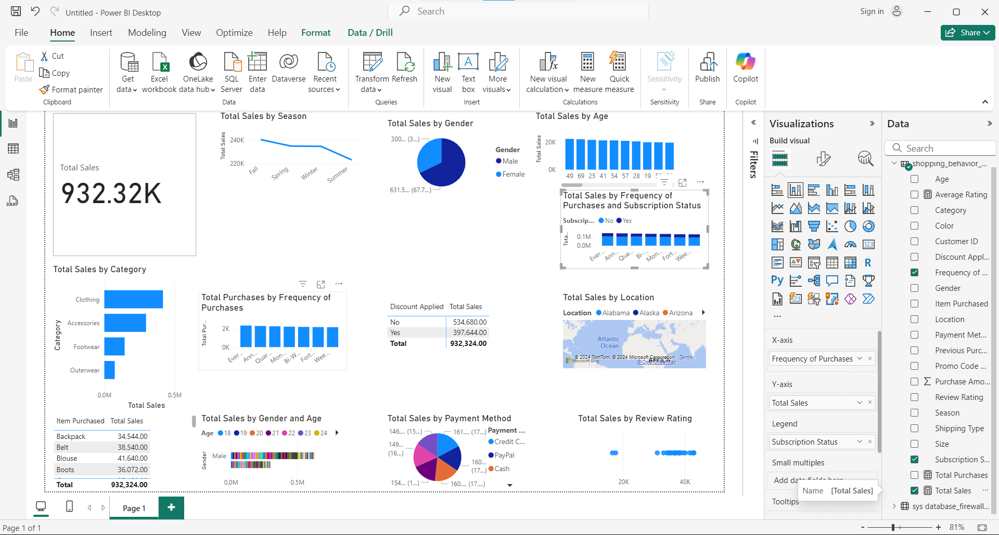

Slide 17
Our Team
Peter Habib
Abdallah
Mohamed Hesham

Slide 18
thank you.

